Slide 1

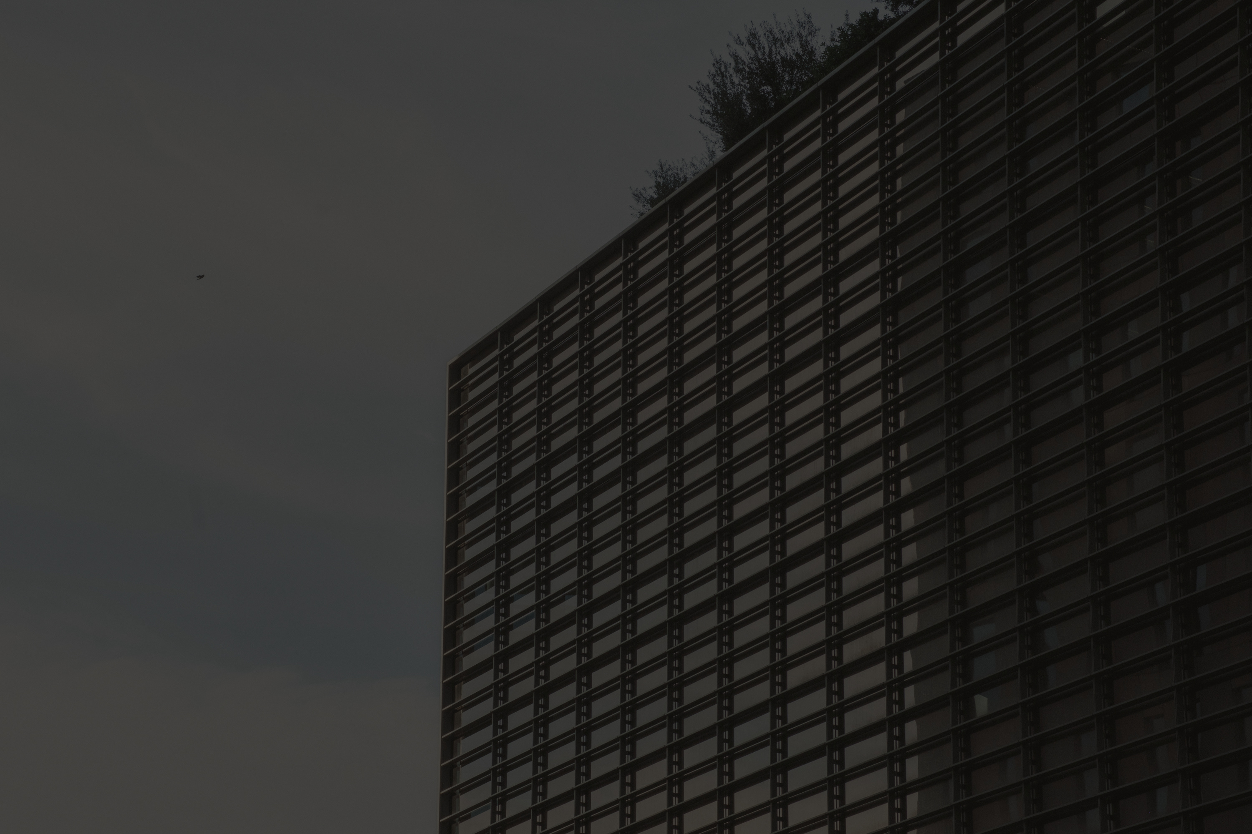
FASHION OUTFIT RECOMMENDATION SYSTEM
Name- Ananya Bhatia(S24CSEU1979)
Aaditri Chandok(S24CSEU1774)
Kashish Kapoor(S24CSEU1764)

Slide 2
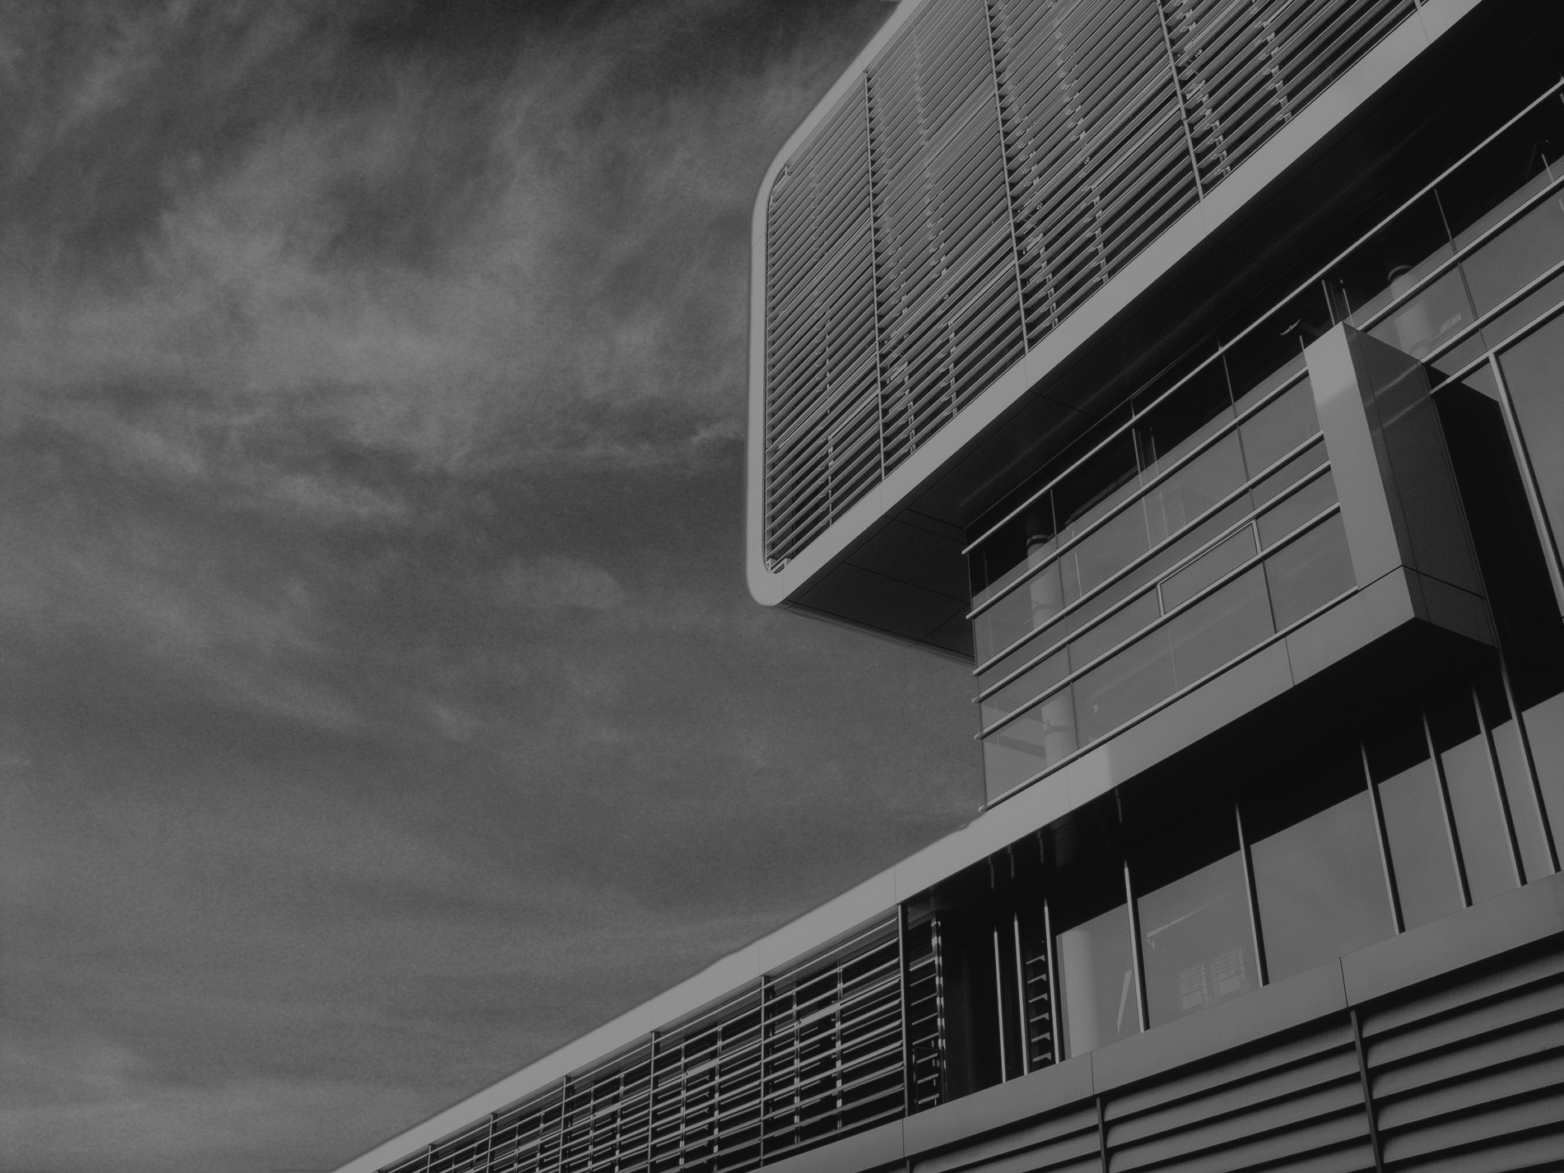
Problem Statement
Choosing a stylish and well-coordinated outfit is challenging for many individuals due to limited fashion knowledge, lack of feedback, or difficulty visualizing improvements. Existing fashion recommendation platforms typically suggest new outfits but rarely provide personalized feedback on what someone is already wearing.
There is a need for an AI system that can analyze a user’s outfit from an uploaded image and provide practical, visually informed suggestions to enhance their overall look. This includes recommendations related to color coordination, fit, accessories, footwear, layering, and overall style alignment.
The Fashion Outfit Recommendation System aims to solve this gap by using computer vision and machine learning techniques to evaluate outfits and offer actionable improvement suggestions. The system processes the uploaded image, identifies clothing items, assesses style aesthetics, and recommends changes that can make the user’s outfit more appealing, balanced, or appropriate for the occasion.
The project addresses the following key problems:
Lack of personalized fashion advice accessible to general users.
No easy way to analyze one’s current outfit and identify what could be improved.
Difficulty in evaluating color harmony, style matching, and overall outfit balance.
Limited AI tools that provide modification suggestions instead of entirely new outfits.
This system will help users enhance their fashion sense by giving AI-driven, image-based outfit improvement recommendations, ultimately boosting confidence and reducing decision fatigue in everyday dressing.

Slide 3
PROPOSED SOLUTION
The project proposes an AI-powered system that analyzes a user’s outfit from an uploaded image and provides personalized improvement suggestions. Using computer vision and deep learning, the system detects clothing items, identifies colors and styles, and evaluates the overall outfit.
It then recommends specific changes such as better color combinations, suitable accessories, improved footwear, or layering options to enhance the look. The system may also generate a visual preview of the improved outfit using generative AI.
This solution offers quick, practical, and personalized fashion guidance based on the user’s current outfit, helping them dress better with minimal effort.

Slide 4
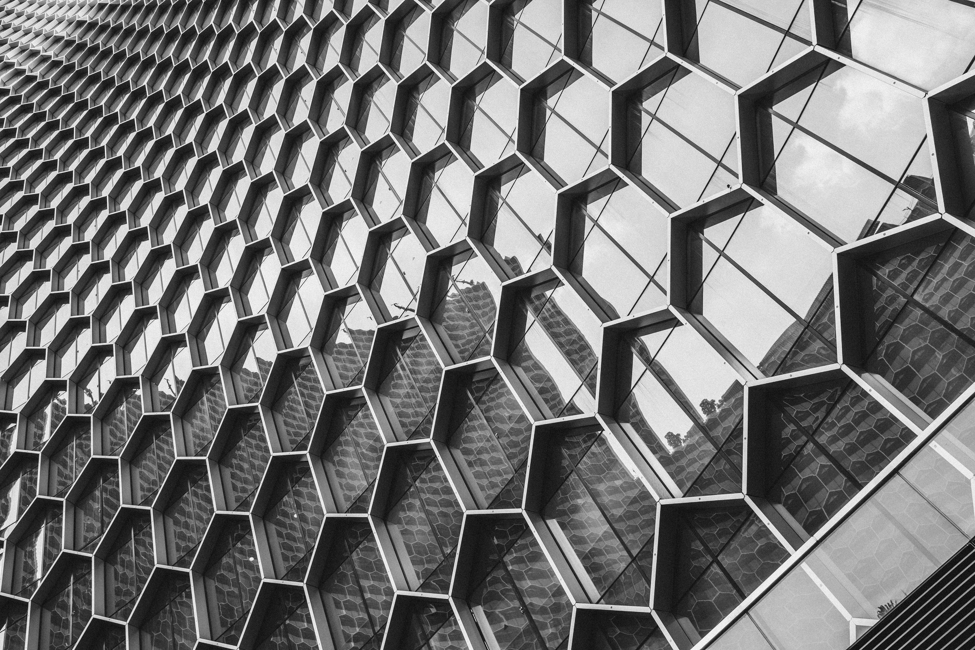
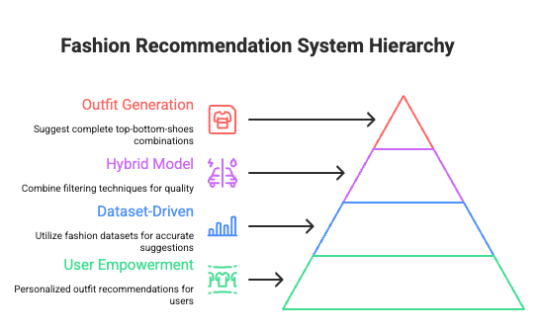


GOALS AND OBJECTIVES
Empowering Users
Diverse Categories
Incorporating AI

Slide 5
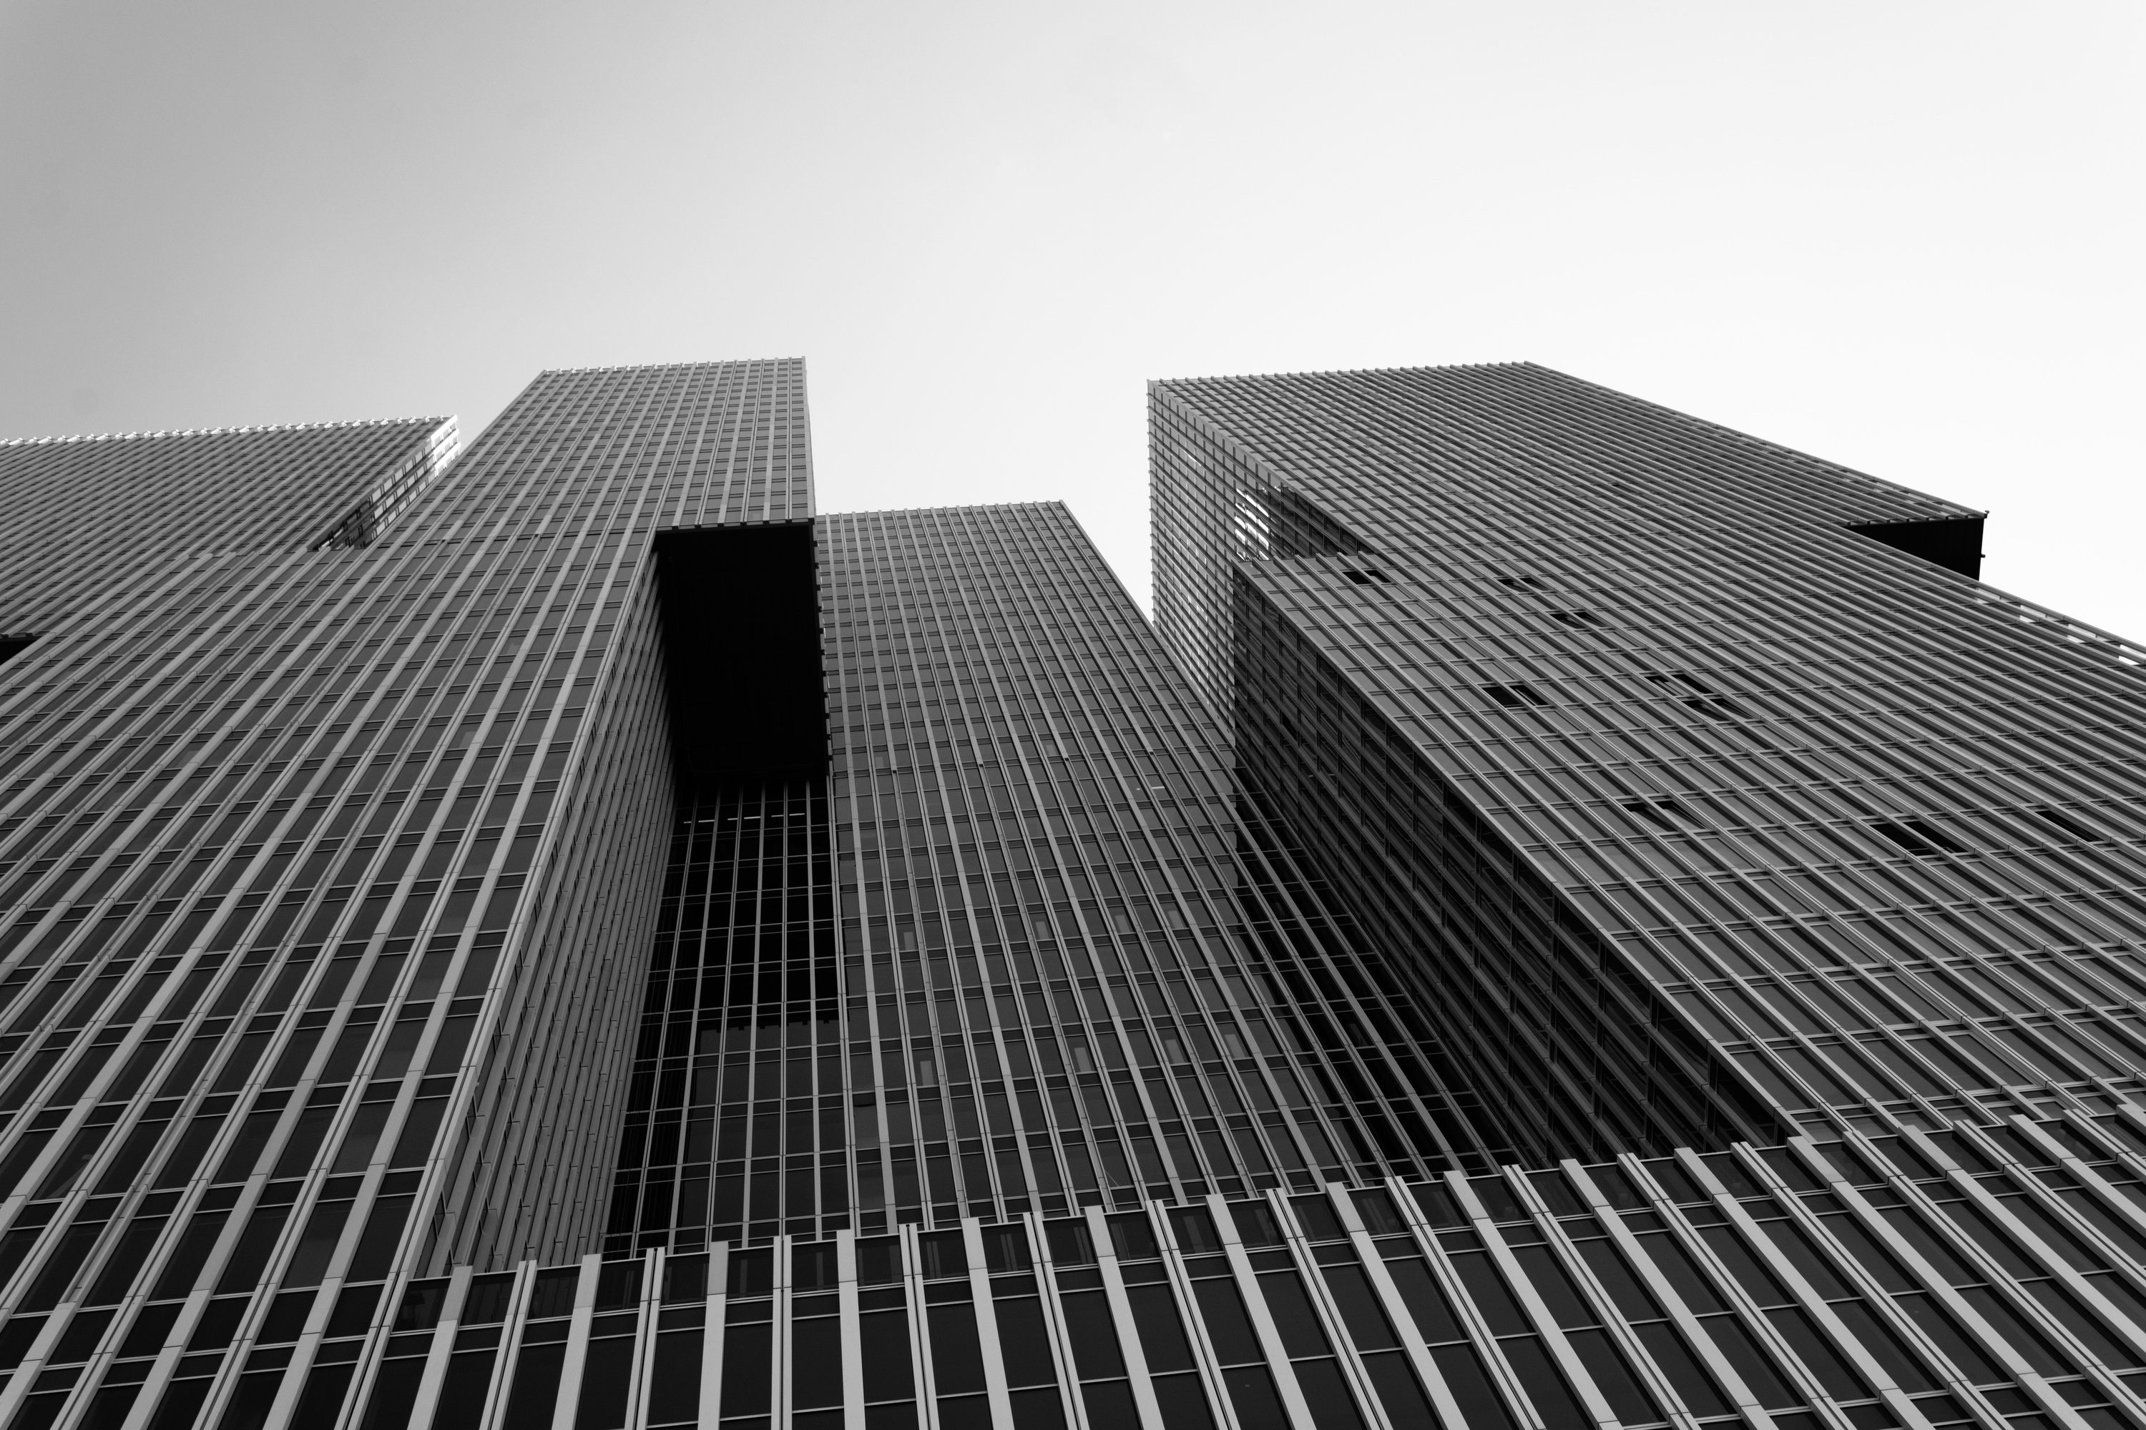

TECHNOLOGY USED
Programming Language
Python 3
Web Framework
Flask
Werkzeug
Jinja2 (via Flask)
Authentication & Sessions
flask-login
Database & ORM
flask-sqlalchemy (SQLAlchemy)
SQLite (default SQLALCHEMY_DATABASE_URI) Project Helpers
Flask extensions module (extensions.py)
Centralizes db and login_manager setup
Machine Learning / Data Processing
scikit-learn
TF-IDF
Random Forest
Train/Test Split
Evaluation Metrics
pandas
numpy
joblib (model saving/loading)
Similarity & Text Feature Extraction
TfidfVectorizer
cosine_similarity
Image Processing
Pillow (PIL)
OpenCV (opencv-python)
Utilities
Requests, werkzeug.utils.secure_filename

Slide 6
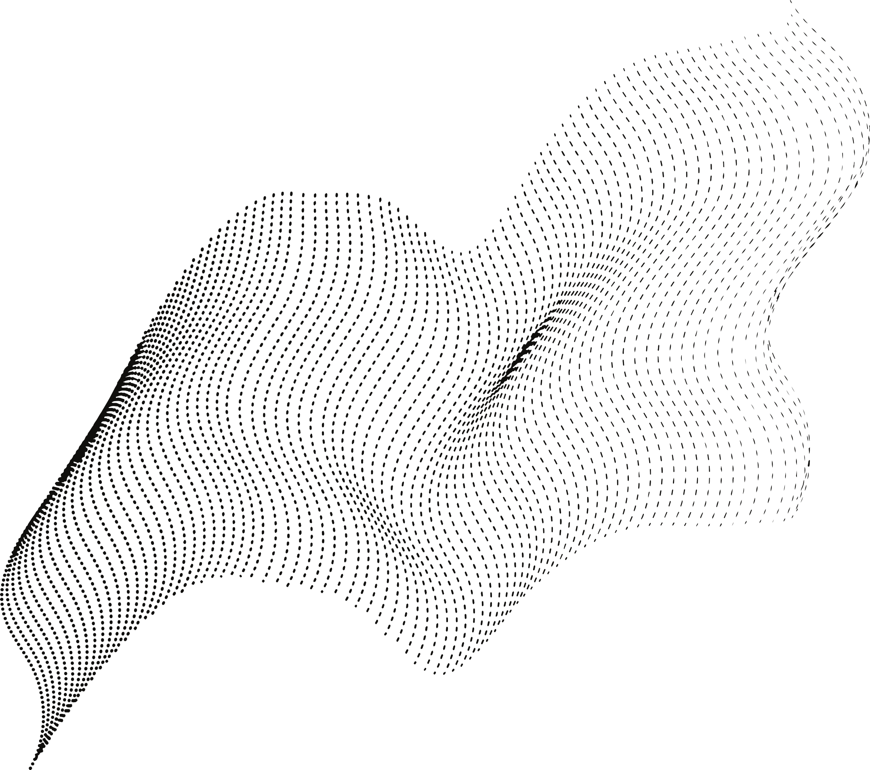
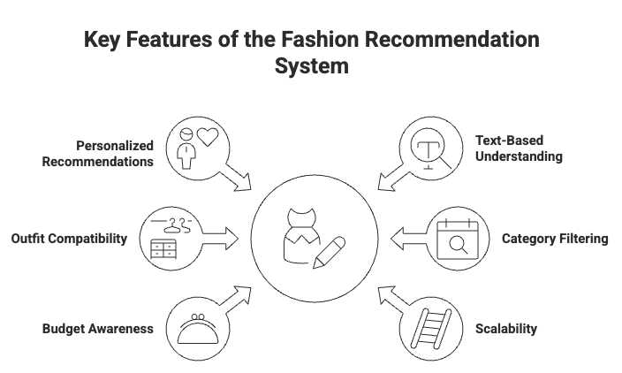

Slide 7

Future
Prospects
Advanced Outfit Generation
Use generative AI (Stable Diffusion, GANs) to create complete improved outfit previews.
Virtual Try-On System
Allow users to try different clothing combinations digitally.
Occasion-Based Recommendations
Suggest outfits based on events like college, office, parties, festivals, etc.
Personalized Style Learning
System adapts to user preferences and past likes/dislikes for more accurate suggestions.
E-Commerce Integration
Recommend similar or better clothing items directly available for purchase.
Body Shape & Fit Analysis
Provide suggestions tailored to user body proportions for better fit and comfort.
Real-Time Outfit Feedback
Mobile app version that gives instant feedback using live camera input.

Slide 8
Thank You!

